Slide 1

Understanding COVID-19: Analysis of Cases and Vaccination Rates

Slide 2
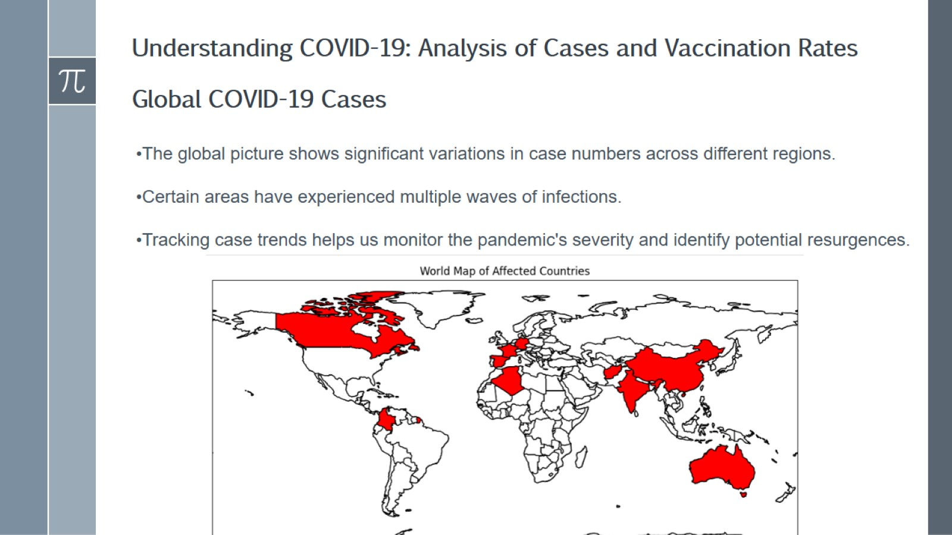
Understanding COVID-19: Analysis of Cases and Vaccination Rates Global COVID-19 Cases

Slide 3


Slide 4
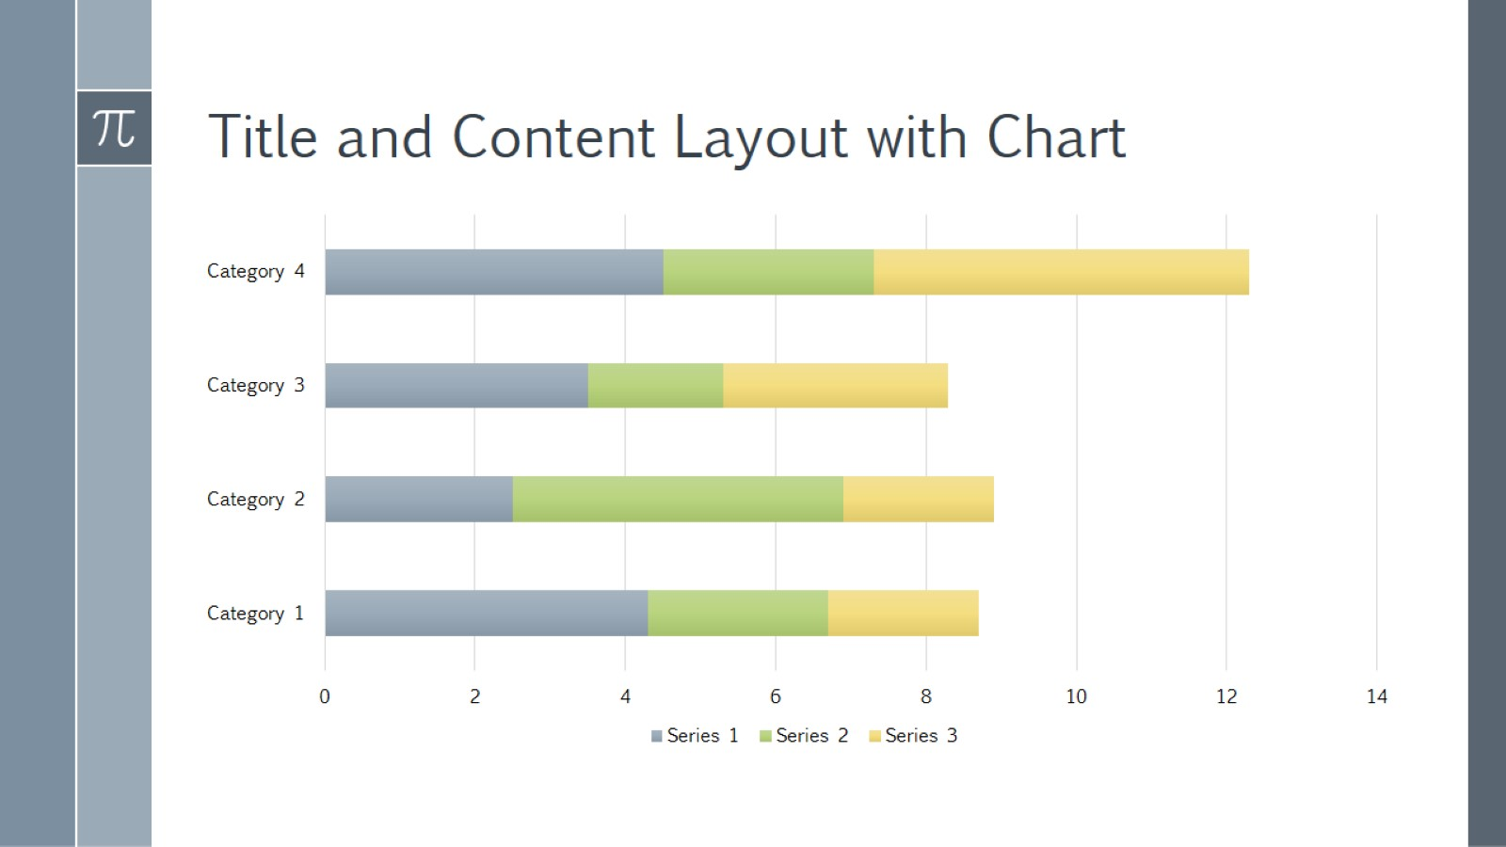
Title and Content Layout with Chart

Slide 5
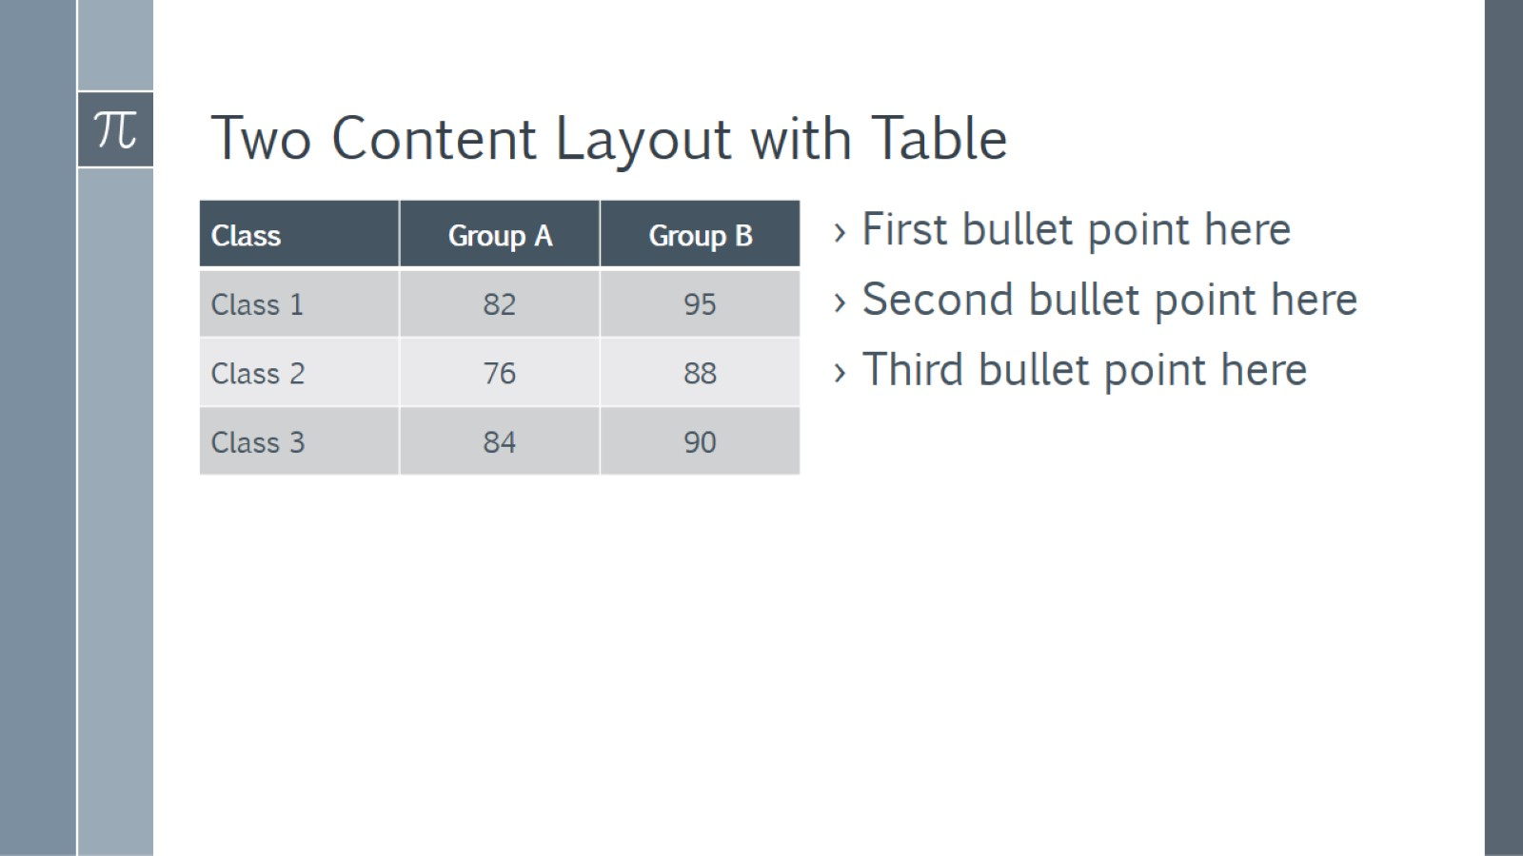
Two Content Layout with Table

Slide 6
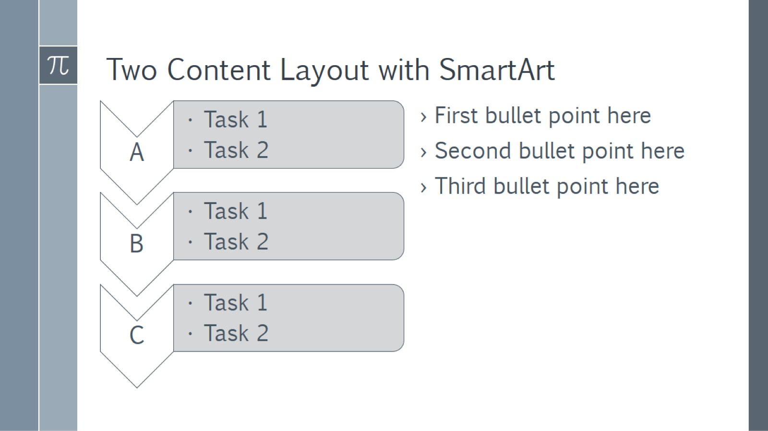
Two Content Layout with SmartArt

Slide 7

Add a Slide Title - 1

Slide 8

Add a Slide Title - 2

Slide 9
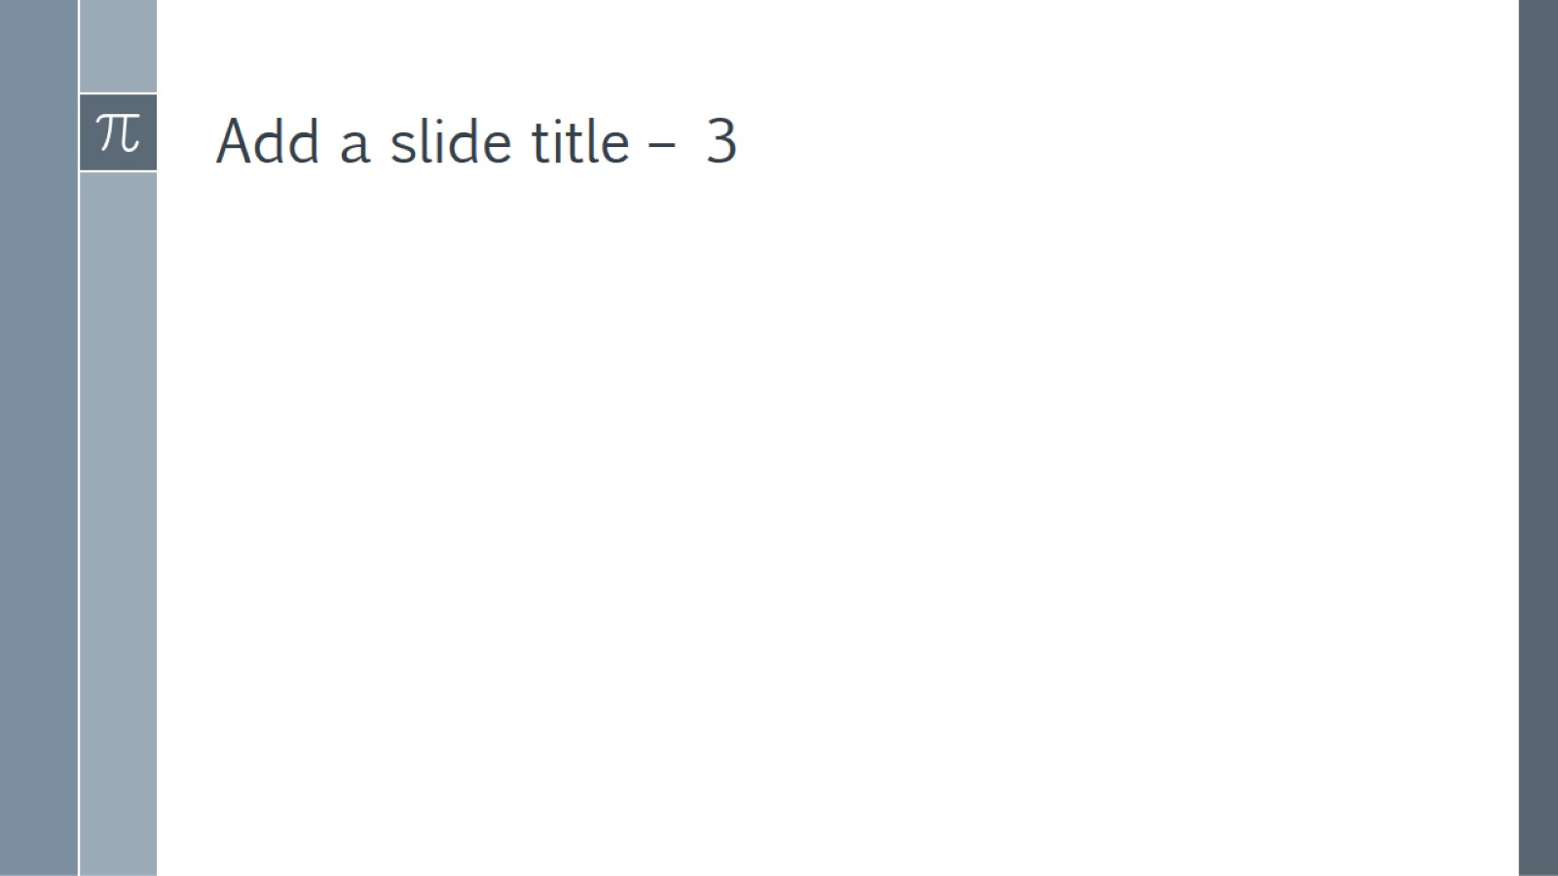
Add a slide title – 3

Slide 10


Slide 11

Add a Slide Title - 4

Slide 12

Add a Slide Title - 5

